Slide 1
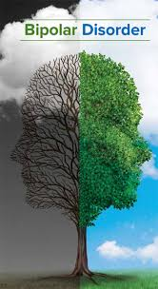

Slide 2
Introduction
Bipolar disorder is a mental condition that is associated with severe and extreme mood swings that include emotional highs and lows.
Bipolar is a lifelong condition and this mood swings that affects behavior, judgments and decisions and ability of one to think clearly during their lifetime.

Slide 3
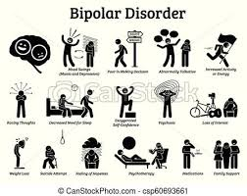

Slide 4
Physical changes
Hallucinations
Low attention and concentrations to projects since they feel distracted.
Insomnia and sleeping problems.
Higher than usual frequency of talking.
high or irritated mood.

Slide 5
Social changes
Individuals suffering from bipolar disorders always become irritated by the least provocations, some of which can be ignored such as noises, smells among others.
Rapid mood changes
Outburst aggression
Explosive anger with a consequent reckless and uncontrolled behavior

Slide 6
Emotional
Those with bipolar disorder always have seriously impaired emotional feelings, for example during euphoria.
Psychosis which can occur during both high and low episodes; due to the emotional distortions, persons are unable to differentiate between reality and fantasy.

Slide 7
Cognitive changes
Patients with bipolar disorder have reduced neuropsychological ability that significantly affects the psychological functioning of their brains.
Causes negative effect on memory and speed of information processing among patient.
Causes neurocognitive dysfunction.

Slide 8
Community resources
To identify the initial signs that show the beginning of an episode and focus on the factors that help maintain the normalcy of the periods as long as possible.
Through cognitive behavioral therapy as family-focused therapy that is focused on preventing relapses.

Slide 9
Role of HCA
It conduct and support research on bipolar disorder subsequently increasing and widening our understanding of its causes and help develop new treatments.
HCA have continued to study genetics and bipolar disorder, cognitive brain function among children and adolescents who have bipolar disorder as well as their family history and behavior.

Slide 10
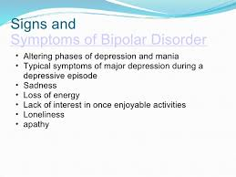

Slide 11
References
Bernstein, E. E., Rabideau, D. J., Gigler, M. E., Nierenberg, A. A., Deckersbach, T., & Sylvia, L. G. (2016). Patient perceptions of physical health and bipolar symptoms: The intersection of mental and physical health. Journal of affective disorders, 189, 203-206.
Grande, I., Berk, M., Birmaher, B., & Vieta, E. (2016). Bipolar disorder. The Lancet, 387(10027), 1561-1572.

Slide 12
References
Guilera, G., Gómez-Benito, J., Pino, Ó., Rojo, E., Vieta, E., Cuesta, M. J., ... & Martínez-Arán, A. (2015). Disability in bipolar I disorder: the 36-item world health organization disability assessment schedule 2.0. Journal of Affective Disorders, 174, 353-360.
Hospitals Corporation of America, (HCA). Diagnostic and Statistical Manual of Mental Disorders, Third Edition - Text Revision (DSMIV-TR) American Psychiatric Publishing Incorporated; 2000

